Slide 1
ARITHMETICAL REASONING

Slide 2
CONTENTS:
Venn diagram based problems
Inequalities
Mathematical operations

Slide 3
Venn diagram based problems:
Venn, a British mathematician, developed what are called Venn diagrams mainly to illustrate the principles of Set Theory and certain operations on sets.
This type of diagram is extensively used in scientific and engineering presentations, in theoretical Mathematics, in Computer applications and in Statistics.
In general, Venn Diagrams are logical diagrams, in which various items and their relationships are represented by circles or other types of diagrams.

Slide 4
In these questions, you will be presented with different classes or groups of familiar objects and you will be asked to identify their mutual relationships.
This requires a logical understanding and careful observation of diagrams.
The following Applications will explain the different types of questions under this category.

Slide 5
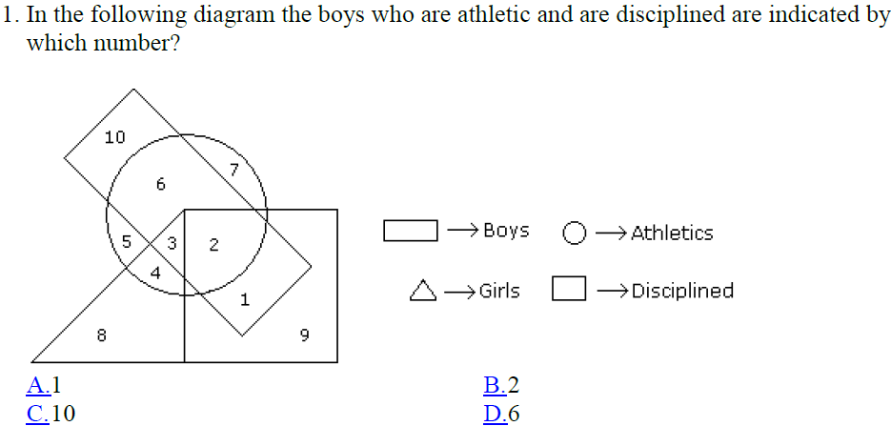
Logical Venn diagrams:

Slide 6
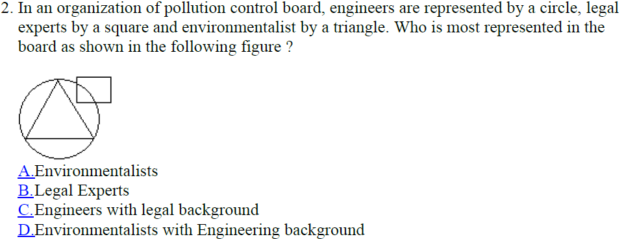

Slide 7
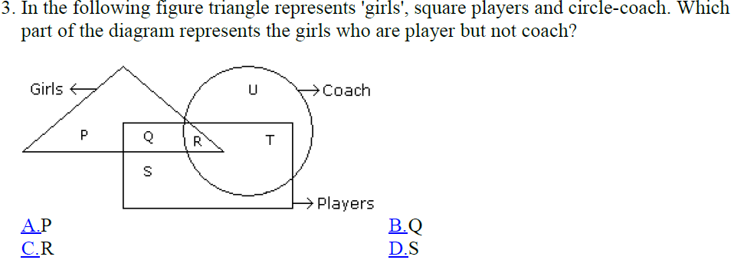

Slide 8
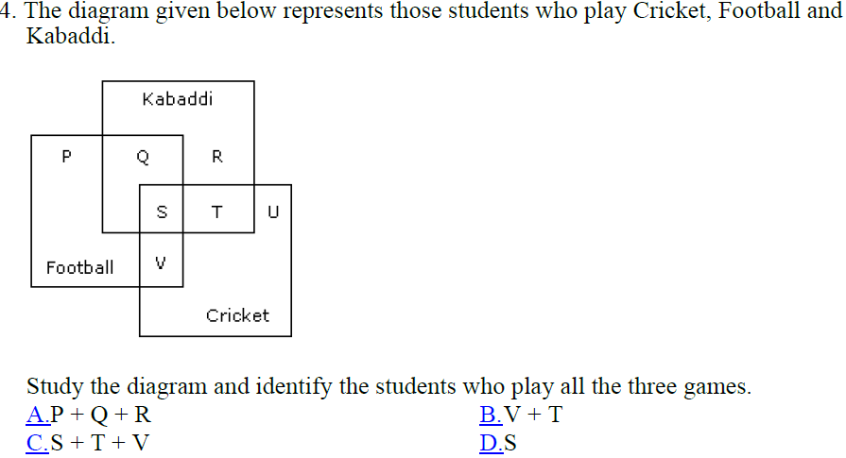

Slide 9
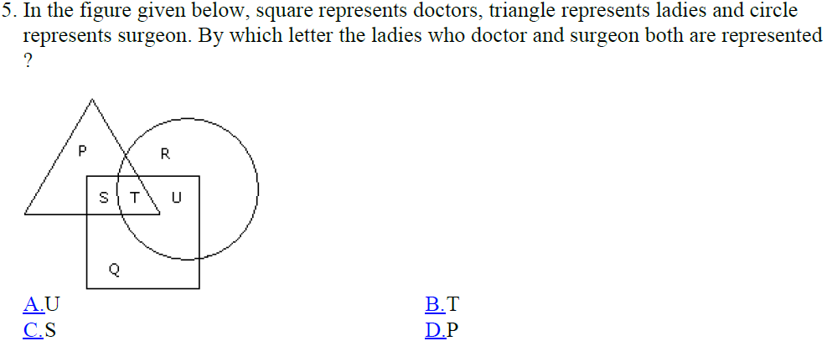

Slide 10
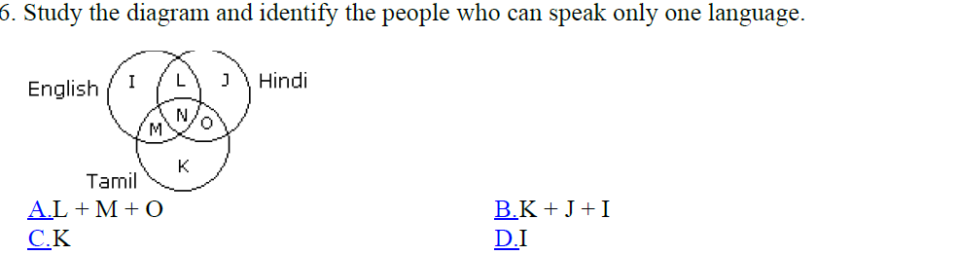
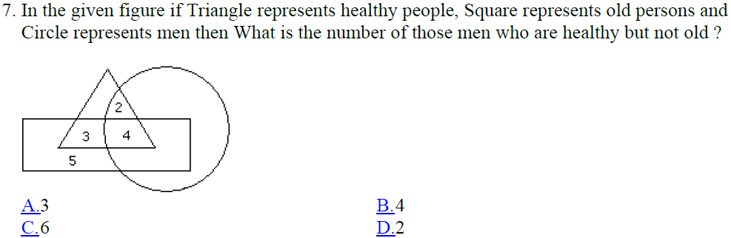

Slide 11
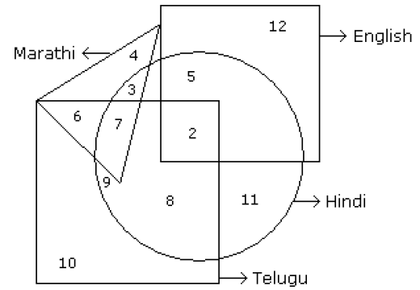

Answer from the following figure:

Slide 12





Slide 13
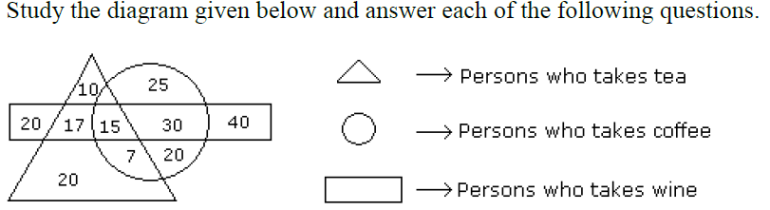
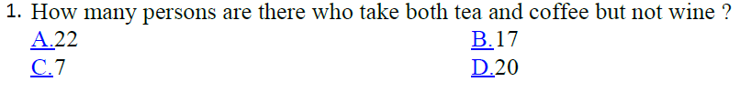
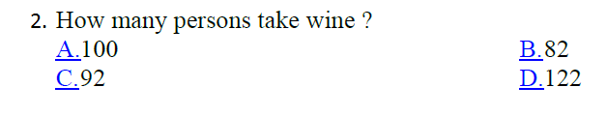

Slide 14
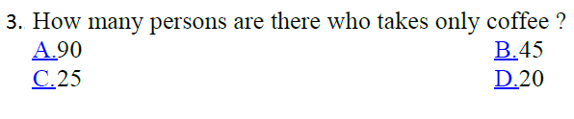


Slide 15
Practice questions:
In a survey, it was found that 65% of the people would watch news on TV, 40% read in newspaper, 25% read newspaper and watched TV. What percentage of people neither watched TV nor read newspaper?
0%
5%
10%
20%

Slide 16
In a class, 20 opted for Physics, 17 for Math's, 5 for both and 10 for other subjects. The class contains how many students?
35
42
52
60

Slide 17
In a class consisting of 100 students, 20 know English and 20 do not know Hindi and 10 know neither English nor Hindi. The number of students knowing both Hindi and English is
5
10
15
20

Slide 18
Each student in a class of 40 plays at least one indoor game chess, carrom and scrabble. 18 play chess, 20 play scrabble and 27 play carrom. 7 play chess and scrabble, 12 play scrabble and carrom and 4 play chess, carrom and scrabble. Find the number of students who play (i) chess and carrom. (ii) chess, carrom but not scrabble.

Slide 19
In a competition, a school awarded medals in different categories. 36 medals in dance, 12 medals in dramatics and 18 medals in music. If these medals went to a total of 45 persons and only 4 persons got medals in all the three categories, how many received medals in exactly two of these categories?
12
13
14
15

Slide 20
In a survey of brand preference for toothpastes, 82% of the population (number of people covered for the survey) liked at least one of the brands I, II and III. 40% of those liked brand I, 25% liked brand II and 35% liked brand III. If 5% of those showed liking for all the three brands, then what percentage of those liked more than one of the three brands?
13
10
8
5

Slide 21
In a class of 50 students, 18 take Chorus, 26 take Band, and 2 take both Chorus and Band. How many students in the class are not enrolled in either Chorus or Band?
12
4
8
6

Slide 22
A veterinarian surveys 26 of his patrons. He discovers that 14 have dogs, 10 have cats, and 5 have fish. Four have dogs and cats, 3 have dogs and fish, and one has a cat and fish. If no one has all three kinds of pets, how many patrons have none of these pets?
6
0
5
3

Slide 23
Inequalities:
There are two types of questions in Inequality –
1) Coded Inequality
2) Direct Inequality
Both kinds of questions can be solved easily once you have gone through the below tables.

Slide 24
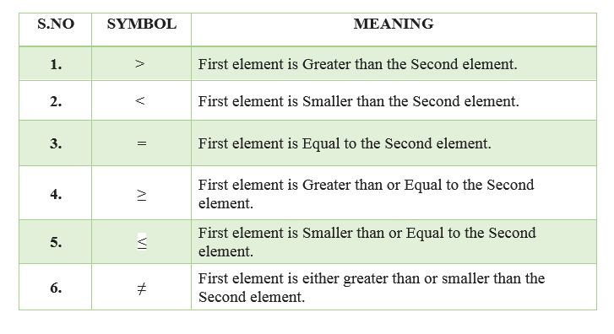
In order to understand questions on inequality first you need to have an overview of various terminologies which are used in such questions –

Slide 25
The table given below gives the relationship between certain statements and their conclusions. Once you have learnt and understood these concepts, questions on inequality will be much easier to solve.

Slide 26
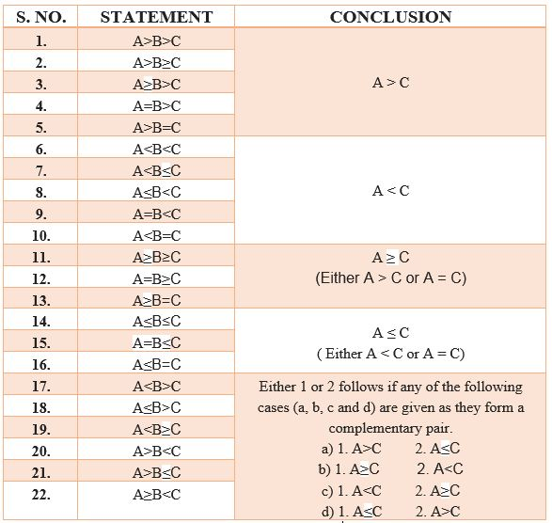

Slide 27
Practice examples:
‘P©Q’ means ‘P’ is greater than ‘Q’.
‘P%Q’ means ‘P’ is smaller than ‘Q’.
‘P@Q’ means ‘P’ is either greater than or equal ‘Q’.
‘P$Q’ means ‘P’ is either smaller than or equal to ‘Q’.
‘P#Q’ means ‘P’ is equal to ‘Q’.
A) If only conclusion I is true.
B) If only conclusion II is true.
C) If either conclusion I or II is true.
D) If neither conclusion I nor II is true.
E) If both conclusions I and II are true

Slide 28
Statements:
M @ R, R ©F, F#L
Conclusions:
R@L
M@L
Ans: D
Statements:
T % J, J @ V, V # W
Conclusions:
T©W
W@T
Ans: C

Slide 29
Statements:
J @ D, D$ L, L#N
Conclusions:
J # L
J $ L
Ans: D
Statements:
R $ M, M%H,H$F
Conclusions:
R % F
M $ F
Ans: A

Slide 30
Statements:
K $ H, H % I, I © F
Conclusions:
K $ I
H % F
Ans: D

Slide 31
Practice questions:
In the question symbols *, @, %, $ and # are used with the following meaning.
'P $ Q' means 'P is not greater than Q'
'P * Q' means 'P is neither smaller than nor greater than Q'
'P # Q' means 'P is neither greater than nor equal to Q'
'P % Q' means 'P is not smaller than Q'
'P @ Q' means 'P is neither smaller than nor equal to Q'
Assuming the statements to be true, find out which of the two conclusions I and II is/are definitely true.
Statements:
D % H, K * H, H $ R
Conclusions
I. K $ R
II. D % K
(a) Only conclusion I is true
(b) Only conclusion II is true
(c) Either conclusion I or II is true
(d) Neither conclusion I nor II
is true
(e) Both follows

Slide 32
Given signs signify something and on that basis, assume the given statements to be true and find which of the two conclusions I and II is/are definitely true.
A+B means A is equal to B
A-B means A is less than B
A=B means A is not equal to B
A*B means A is greater than equal to B
A/B means A is less than equal to B
Statements
K+L, K/M, M-N
Conclusions
I) M+L
II) K-N
(a) Only conclusion I is true
(b) Only conclusion II is true
(c) Neither conclusion I nor II is true
(d) Both conclusions I and II are true

Slide 33
Given signs signify something and on that basis, assume the given statements to be true and find which of the two conclusions I and II is/are definitely true.
A * B means A is not greater than B.
A │B means A is nether smaller than nor equal to B.
A / B means A is not smaller than B.
A \ B means A is neither greater than nor equal to B.
A ? B means A is neither greater than nor smaller than B.
Statements:
M ? S │ Q │ P, R / P, T \ P
Conclusions:
I) M │ T
II) Q \ R
(a) Only conclusion I is true
(b) Only conclusion II is true
(c) Neither conclusion I nor II is
true
(d) Both conclusions I and II are
true

Slide 34
Given signs signify something and on that basis, assume the given statements to be true and find which of the two conclusions
I and II is/are definitely true.
A+B means A is greater than equal to B
A-B means A is equal to B
A€B means A is less than B
A*B means A is equal to B
A/B means A is greater than equal to B
Statements:
D * G, G – H, H / J
Conclusions:
I) D ≠ H
II) G / J
(a) Only I is true
(b) Only II is true
(c) Both are correct
(d) None of these are true

Slide 35
Given signs signify something and on that basis, assume the given statements to be true and find which of the two conclusions I and II is/are definitely true.
A+B means A is equal to B
A-B means A is less than B
A=B means A is not equal to B
A*B means A is greater than equal to B
A/B means A is less than equal to B
Statements:
Q+R, R*S, S–T
Conclusions:
I) S*T
II) Q=R
(a) Only conclusion I is true
(b) Only conclusion II is true
(c) Neither conclusion I nor II
is true
(d) Both conclusions I and II
are true

Slide 36
Mathematical operations:
In this type, you are provided with substitutes for various mathematical symbols, followed by a question involving calculation of an expression or choosing the correct / incorrect equation. The candidate is required to put in the real signs in the given equation and then solve the questions as required. Note: - While solving a mathematical expression, proceed according to the rule
BODMAS – i.e. Brackets, Of, Division, Multiplication, Addition, Subtraction.

Slide 37
Practice Examples:
If × stands for 'addition', ÷ stands for 'subtraction', + stands for 'multiplication' and - stands for 'division', then 20 × 8 ÷ 8 - 4 + 2 = ?
80
25
24
5
Ans: C

Slide 38
If - means ×, × means +, + means ÷ and ÷ means -, then 40 × 12 + 3 - 6 ÷ 60 = ?
7.95
44
20
None of these
Ans: D

Slide 39
If + means ÷, × means -, ÷ means × and - means+, than 8 + 6 × 4 ÷ 3 - 4 = ?
-12
20/3
-20/3
-20
Ans: C

Slide 40
If × means ÷, - means ×, ÷ means + and + means-, than (3 - 15 ÷ 19) × 8 + 6 = ?
8
6
5
2
Ans: D

Slide 41
If + means ×, ÷ means -, × means ÷ and - means +, what will be the value of 4 + 11 ÷ 5 - 55 = ?
23
45
29.3
None of these
Ans: D

Slide 42


